Slide 1


An Introduction to R
Workshop 2
Please record your attendance:
Laura Dean
LIFE4138
laura.dean@nottingham.ac.uk

Slide 2

Homework recap
Let’s go through the answers to the homework from last session

Slide 3
Learning objectives and outcomes
Gain an introduction to different R ‘philosophies’
Understand pipes in R
Subset data with baseR and dplyr
Summarise data with dplyr
Learn what wide and long data formats are and how to convert from one to the other
Build more complex plots with ggplot2

Slide 4

Different ways to approach R
baseR
The ”original” approach to R
What we have used so far
Focuses mainly on vectors
Tidyverse
Cohesive set of packages with a singular philosophy
Aims to enhance readability and reproducibility
Focuses on data frames
NB. Other approaches do exist – i.e. data.table
Notes:
There are many many ways that we can approach our coding in R. The original way, baseR, is what we covered in the last session. It was originally built on vector-based data, way back when R was first developed in the early 90s.
Another common approach to using R is a method known as tidyR, which utilises a selection of packages called **the tidyverse**. Each of the packages within the tidyverse are built with the same underlying ethos, which is the ability to make R code more readable and reproducible. The focus of data handling in the tidyverse is the ```data.frame``` object as an entire entity, rather than the vectors within.
There are several other popular R philosophies (for e.g. the ```data.table``` philosophy), but we wont delve into those here, we'll stick to baseR and the tidyverse.

Slide 5
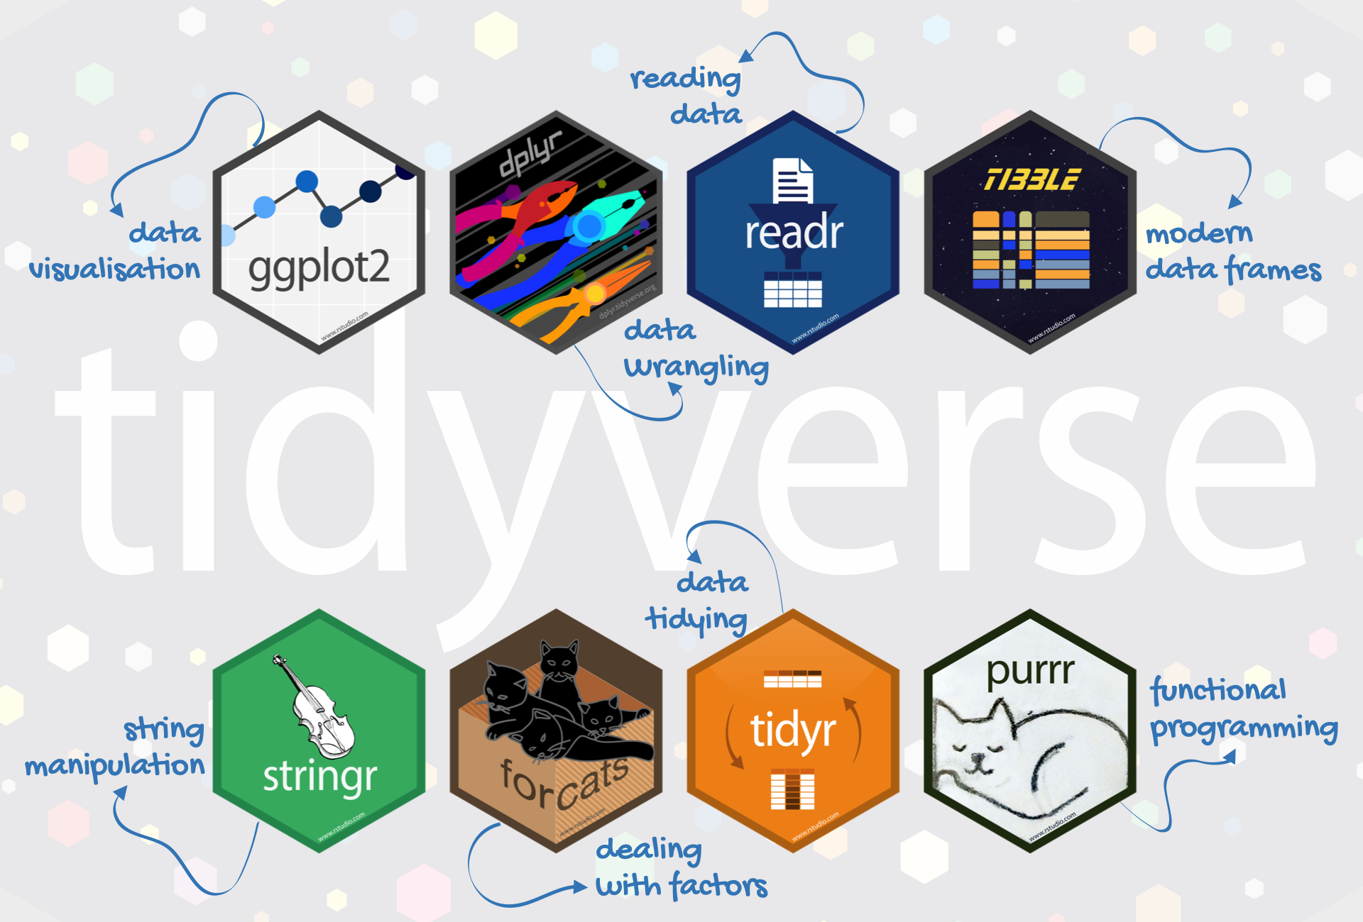
The tidyverse family of packages
Notes:
The tidyverse is a diverse set of packages for data handling, manipulation and plotting
We won’t have time to learn them all, we will focus on dplyr and ggplot2

Slide 6

Data manipulation and dpylr
What is data manipulation?
Exploring and understanding data
Extracting important information
Getting data into shape for downstream analysis
Seemingly boring – but a crucial part of bioinformatics!
dplyr package is explicitly designed to simplify data manipulation in R
Artwork by @allison_horst

Slide 7
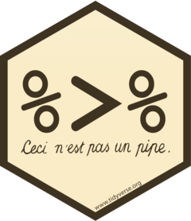
Using pipes in R
From magrittr package
Very similar in principle to how pipes work in Unix
Allows you to chain together functions and to produce more readable code
Start with your data, send it to another function and so on
Facilitates building more complex code blocks
Very useful for data manipulation

Slide 8
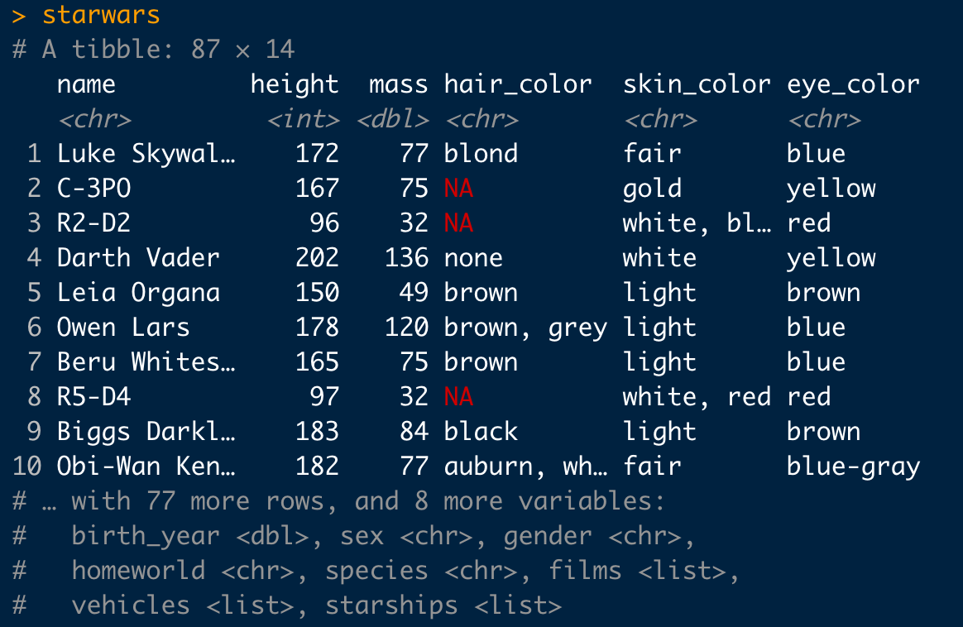
The ins and outs of a tibble
A tibble is an updated data.frame
The clearest difference is that it provides a more detailed summary of the data
Displays class of each column
Otherwise behaves like a standard data.frame
<dbl> is a floating point number with any potential value from -Inf to Inf.
Notes:
A floating point number is essentially a number with a decimal place

Slide 9
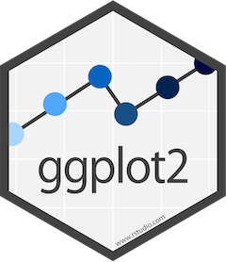
Plotting with ggplot2
Data wrangling is one way to explore data – visualisation is another
gg – “grammar of graphics”
Key components:
Requires data in a data.frame (or tibble)
A coordinate system – built from mappable variables
Layers or geometries – i.e. geom - that actually plot the data
Sounds complex but relatively easy to get to grips with
Analogous to layer-based raster or vector graphics editors
Notes:
Gold standard for plotting in R
Many additional packages
There are three key components to any graphics created in ggplot:
* A data.frame or tibble (where ggplot is getting the data to plot from)
* A co-ordinate based system of mappable variables - i.e. an x and y axis, allowing ggplot2 can map variables to it
* Layers of geometry, or ```geom```, which plot your data.
This sounds quite complicated and abstract, but in reality it's a simple concept - think of ggplot like a raster or vector based image processing/design software like photoshop or GIMP, where you iteratively add layers, building up to your final plot.

Slide 10
Reshaping data for plotting
Long and wide data formats
Sometimes we need to convert from one to the other
Two key functions:
pivot_longer – makes a dataset longer by increasing rows and decreasing columns
pivot_wider – the opposite – increases columns and decreases rows

Slide 11
Reshaping data for plotting
pivot_longer
species | measure | value
setosa | petal_length | 1.4
setosa | petal_width | 0.2
versicolor | petal_length | 4.7
versicolor | petal_width | 1.6
virginica | petal_length | 6.3
virginica | petal_width | 1.8
species | petal_length | petal_width
setosa | 1.4 | 0.2
versicolor | 4.7 | 1.6
virginica | 6.3 | 1.8
pivot_wider

Slide 12

Saving plots
As with almost everything in R – there are multiple ways to achieve this
i.e. you can export via Rstudio menus
Or use functions such as jpg() and pdf()
As always the functions give you more option for customisation

Slide 13
Practical time…
Open R studio and we will work through some examples together
Please record your attendance:

Slide 14
Try it yourself tasks 1:
Load the iris dataset into your environment. Use you preferred method to select the Sepal.Length and Sepal.Width columns
Using dplyr and pipes, select only the columns that start with “P” from the iris data frame
Using dplyr but no pipes, filter the iris dataset to contain only the setosa species
Using dplyr, subset the iris dataset to contain only the Species and Sepal.Length columns for the species virginica
Summarise the number of records for each species in the iris data set
BONUS: use the group_by() and summarise_at() functions to get the means of all of the numeric variables in the iris data set for each species.

Slide 15
Try it yourself tasks 2:
Using the Iris dataset, make a scatter plot of Petal.Length and Petal.Width with ggplot()
Colour the points in your previous plot by species
Using ggplot(), make a histogram of Sepal.Width, play with the binwidth until you think it is appropriate
Using ggplot(), Create a boxplot of Sepal.Length for each species, colour the boxes by species and add your own axis labels
Make your own theme for your boxplot above, get rid of the legend and make the background white
Convert the starwars data to long format using pivot_longer(), select the height and mass columns to lengthen.
BONUS: load the “storms” dataset, pivot longer columns 10 & 11, then make a boxplot of status against value and facet wrap using ‘measure’

Slide 16
Up next
Writing R functions
For loops, if, else and conditional statements
apply, sapply and lapply

Slide 17

Homework!
Homework for this workshop is provided as a jupyter notebook on Moodle and in the github repo: https://github.com/lldean18/LIFE4138-R
Please complete the homework for next session
Please record your attendance:

